Slide 1
Status of TWOLF, TODWL and P3DWL
G. D. Emmitt
Simpson Weather Associates

Slide 2
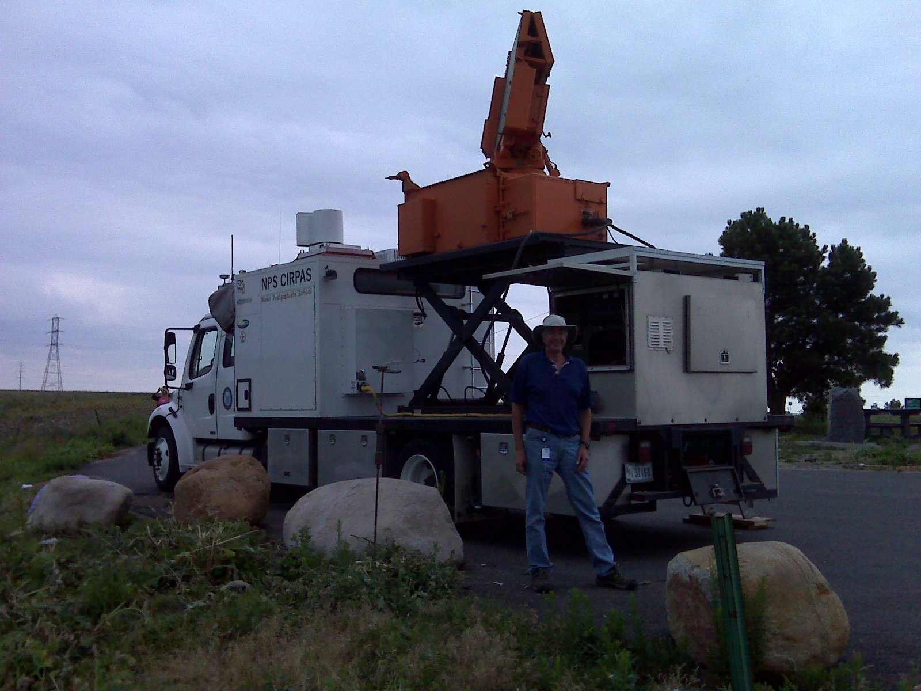
X band Phased-array
TWOLF
Bob Bluth

Slide 3
TWOLF
New scanner purchased and installed on MWR vehicle
Transceiver failed soon after installation in May; returned to LMCT for repair
Postponed tornado deployment till 2013
System transferred to old GWOLF trailer for use by NPS for training students

Slide 4
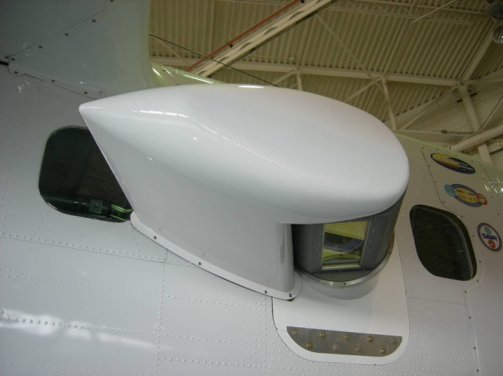
TODWL
Twin Otter Doppler Wind Lidar

Slide 5
TODWL
Funded for 80 hours of flight in August September in Monterey, CA area.
50 hours over water with STP in UPP investigations
30 hours over land w/o STP
Optional use of 20 of the 30 hours at Dugway PG as part of the MATERHORN
  Ferry flights from Monterey to Dugway and 10 -20 additional flight hours would be covered by ARO

Slide 6
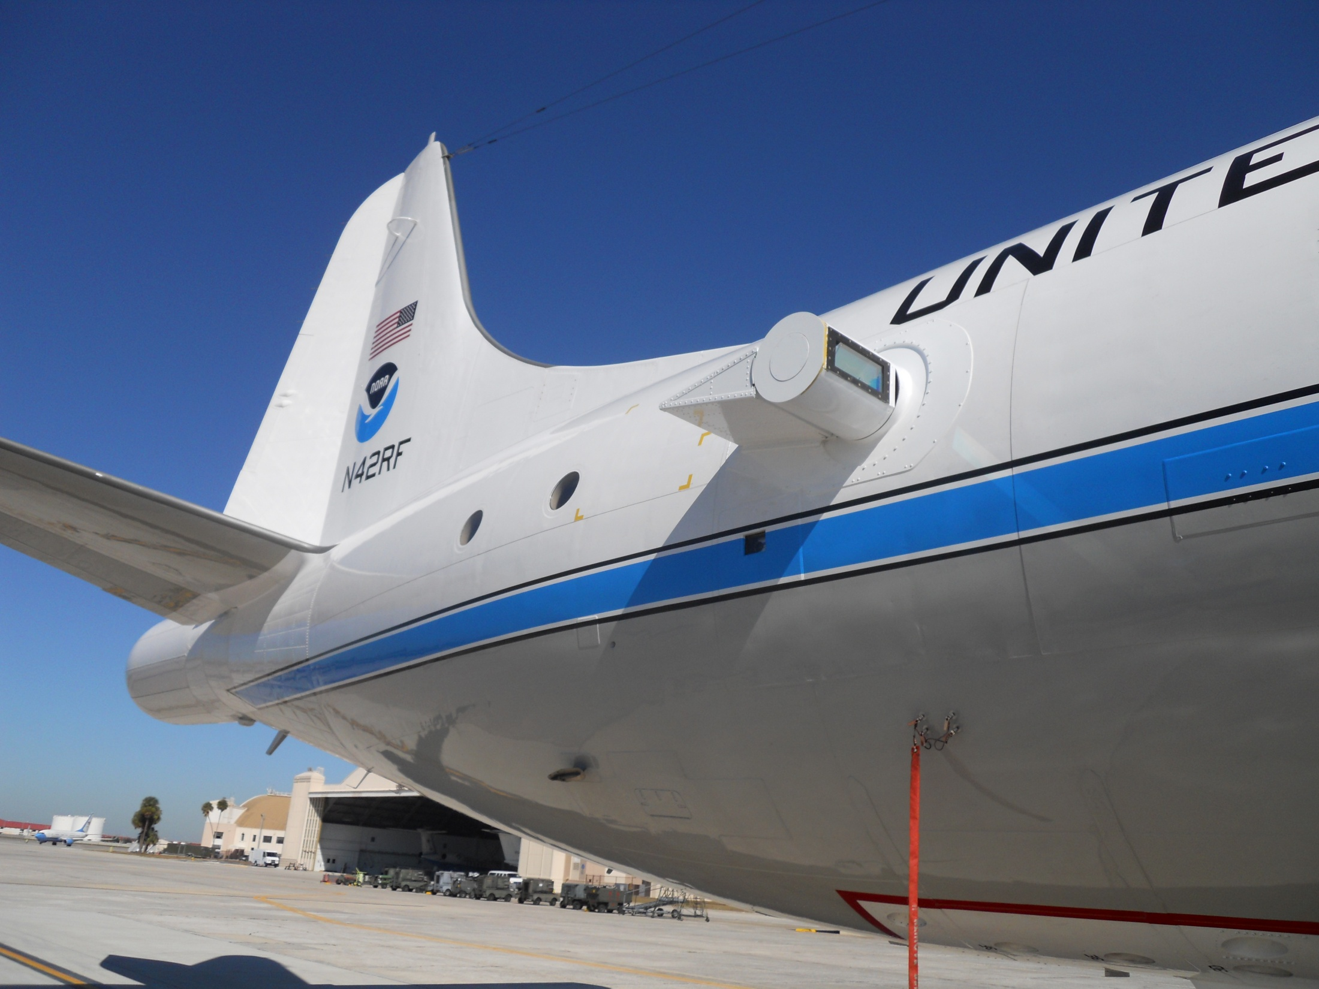

Slide 7
P3DWL (NOAA)
Same system flown on NRL P3 for TPARC/TCS-08 in 2008.
System fully installed in NOAA P3 (N42RF) since beginning of July.
Hardware instabilities are preventing a fully operational mode.
NOAA down a P3 for 2012 season. P3DWL is asked to stand down.
Plan is still in place to bring the system into an operational status with help from LMCT and ARL. Funding is required.

